Slide 1


A swarm of robots for encouraging desired social behaviors
Serge Saaybi
Thesis Status update report
TU Delft | 6 May 2021

Slide 2




Requirements for our swarm system
We will mainly need cheap and easily programable robots
Real-time performance
Sufficient memory to fit the different models
Cost efficiency
Relatively state of the art architecture

Slide 3
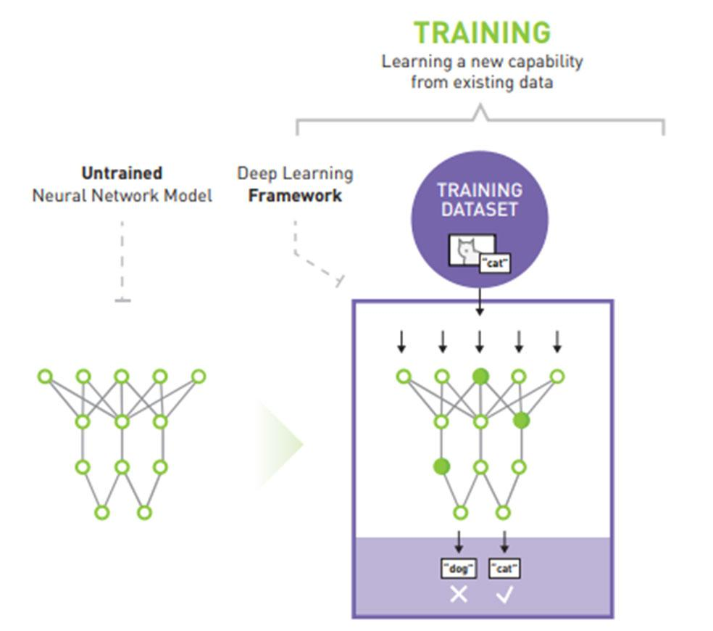
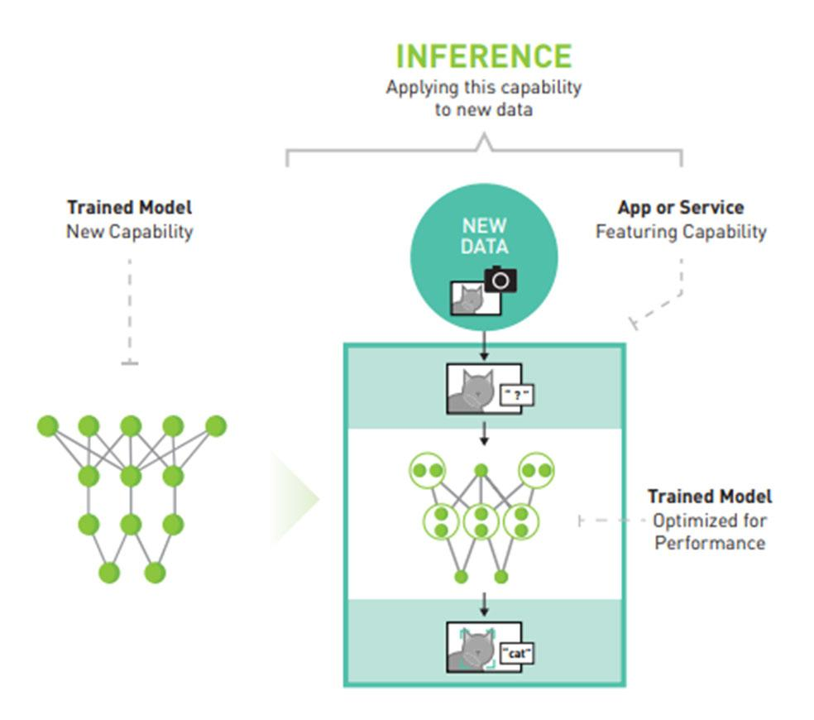
Deploying AI to the field
Difference between Training and Inference of Deep Learning Frameworks
During training, a known data set is put through an untrained neural network. The framework's results is compared with known data set results. Then the framework re-evaluates the error value and updates the weight of the data set in the layers of the neural network based on how correct or incorrect the value is.
Unlike training, inference doesn't re-evaluate or adjust the layers of the neural network based on the results. Inference applies knowledge from a trained neural network model and a uses it to infer a result. So, when a new unknown data set is input through a trained neural network, it outputs a prediction based on predictive accuracy of the neural network.

Slide 4
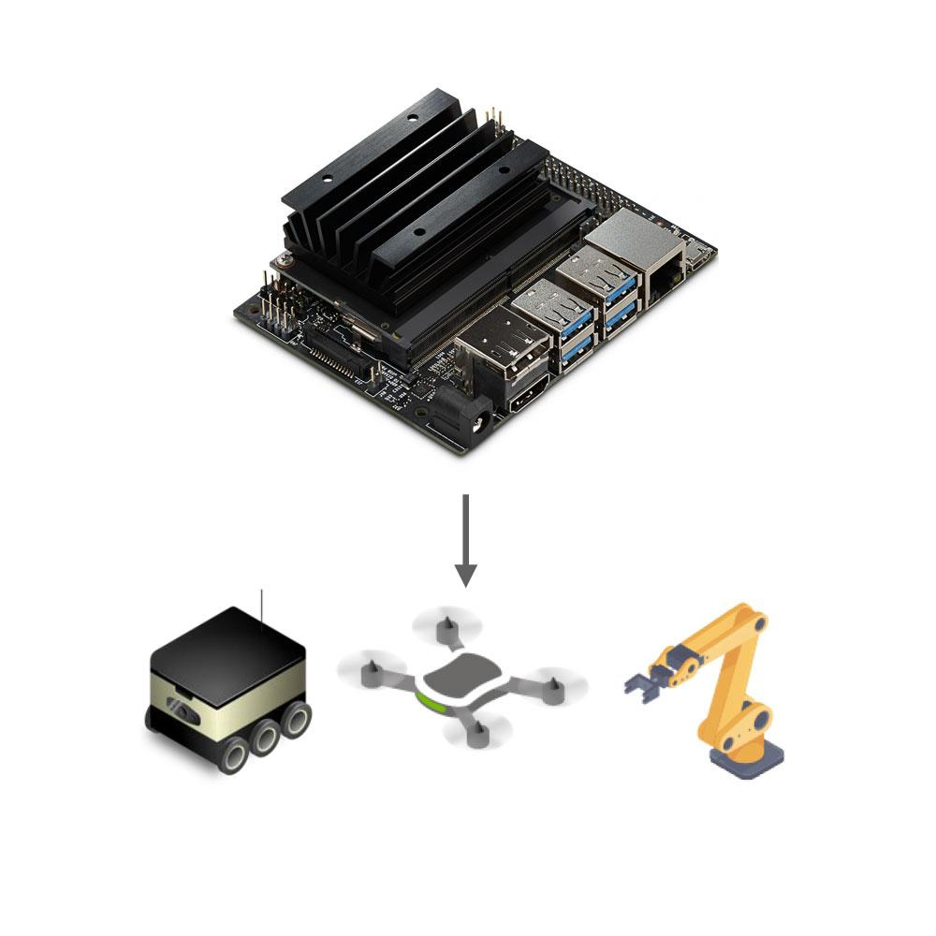
Deploying AI to the field
Inference on the Edge
Single-board computers:
CPU boards
Raspberry Pi- Raspberry pi 4
GPU boards- support online image processing and computer vision algorithms, modern-day model training, and feature extractions
Jetson TX2: one of the most power-efficient and fastest compute boards
Jetson Nano: small and a powerful computer
Jetson Xavier
Content | Raspberry Pi 4 | Jetson Nano | Jetson Xavier NX | Jetson AGX Xavier | Jetson TX2
GPU | NA | NVIDIA Maxwell architecture with 128 NVIDIA CUDA® cores | 384-core NVIDIA Volta™ GPU with 48 Tensor Cores | 512-core Volta GPU with 64 Tensor Cores 11 TFLOPS (FP16) 22 TOPS (INT8) | 256-core NVIDIA Pascal™ GPU architecture with 256 NVIDIA CUDA cores
CPU | Broadcom BCM2711, Quad core Cortex-A72 (ARM v8) 64-bit SoC @ 1.5GHz | Quad-core ARM Cortex-A57 MPCore processor | 6-core NVIDIA Carmel ARM®v8.2 64-bit CPU 6MB L2 + 4MB L3 | 8-core Carmel ARM v8.2 64-bit CPU, 8MB L2 + 4MB L3 | Dual-Core NVIDIA Denver 2 64-Bit CPU Quad-Core ARM® Cortex®-A57 MPCore
Memory | 2GB, 4GB or 8GB LPDDR4-3200 SDRAM (depending on model) | 4 GB 64-bit LPDDR4, 1600MHz 25.6 GB/s | 8 GB 128-bit LPDDR4x @ 1600 MHz 51.2GB/s | 32GB 256-Bit LPDDR4x | 136.5GB/s | 8GB 128-bit LPDDR4 Memory 1866 MHx - 59.7 GB/s
Storage | Micro-SD card slot for loading operating system and data storage | 16 GB eMMC 5.1 | 16 GB eMMC 5.1 | 32GB eMMC 5.1 | 32GB eMMC 5.1
Price | 89.50 € | $129.00 | $479.00 | $999.00 | $479.00
Notes:
https://mitxpc.com/pages/ai-inference-applying-deep-neural-network-training#:~:text=Inference%20applies%20knowledge%20from%20a,accuracy%20of%20the%20neural%20network.
https://developer.nvidia.com/embedded/twodaystoademo
https://www.raspberrypi.org/products/raspberry-pi-4-model-b/?variant=raspberry-pi-4-model-b-4gb&resellerType=education
https://blogs.nvidia.com/blog/2016/08/22/difference-deep-learning-training-inference-ai/

Slide 5
Deploying AI to the field
Hardware used in the literature
Paper | Hardware
Deep reinforcement learning for map-less goal-driven robot navigation | TurtleBot1 robot
Deep Reinforcement learning for real autonomous mobile robot navigation in indoor environments | Turtlebot 2 (Kobuki, 354 x 354 x 420 mm) Nvida Jetson TX1 board (Quad-core ARM Cortex-A57, 256 core Maxwell GPU, 4GB LPDDR4 RAM, 16GB eMMC storage)
Mobile Robot Planner with Low-cost Cameras Using Deep Reinforcement Learning | TurtleBot Burger version 3.0
Robot navigation in cluttered environments with DRL | Turtlebot
Accelerated Sim-to-Real Deep Reinforcement Learning: Learning Collision Avoidance from Human Player | TurtleBot3 Waffle Pi
Deep Reinforcement Learning of Navigation in a Complex and Crowded Environment with a Limited Field of View | NVIDIA Jetson TX2 as a processor
Collective Behavior Acquisition of Real Robotic Swarms using Deep Reinforcement Learning | Robot is powered by a Raspberry Pi and an Arduino
OpenDR — Open Deep Learning Toolkit for Robotics | NVIDIA Jetson TX2 TurtleBot 2
An End-to-End Deep Reinforcement Learning-Based Intelligent Agent Capable of Autonomous Exploration in Unknown Environments | Tekra K1 (TK1, Nvidia, Holmdel, NJ, USA), which has Ubuntu and ROS installed turtlebot
Deep Learning-Based Self-Driving Car: JetBot with NVIDIA AI Board to Deliver Items at Agricultural Workplace with Object-Finding and Avoidance Functions | JetBot NVIDIA Jetson Nano
Deep reinforcement learning for drone navigation using sensor data | Raspberry Pi1 for lightweight processing of simple sensor data, Nvidia Jetson Nano2 for heavier data processing such as image sensor data Intel Nuc3 or Nvidia Jetson4 for more heavyweight processing
Towards continuous control for mobile robot navigation: A reinforcement learning and slam based approach | The experiments were conducted on an Ubuntu 16.04 machine with an Intel Core i7-8550 CPU and a NVIDIA Jetson TX2 GPU Husarion mobile robot with skid-steering model
Self-supervised Deep Reinforcement Learning with Generalized Computation Graphs for Robot Navigation | An Arduino Uno parses the sensors, while the upgraded NVIDIA Jetson TX2 offers increased computational power to run our algorithms RC car- The computer onboard the RC car is an NVIDIA Jetson TX1
Autonomous Social Distancing in Urban Environments using a Quadruped Robot | NVIDIA Jetson AGX Xavier as the vision computational module
COVID-Robot: Monitoring Social Distancing Constraints in Crowded Scenarios | Mount a computer on the turtlebot 2 for pedestrian detection and tracking

Slide 6
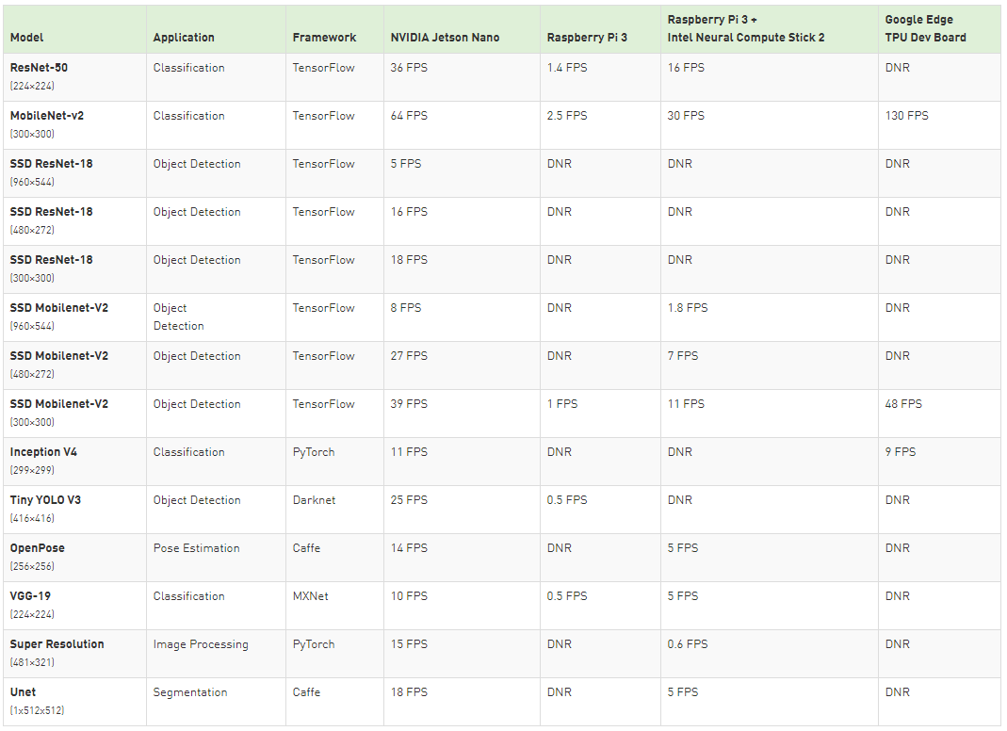
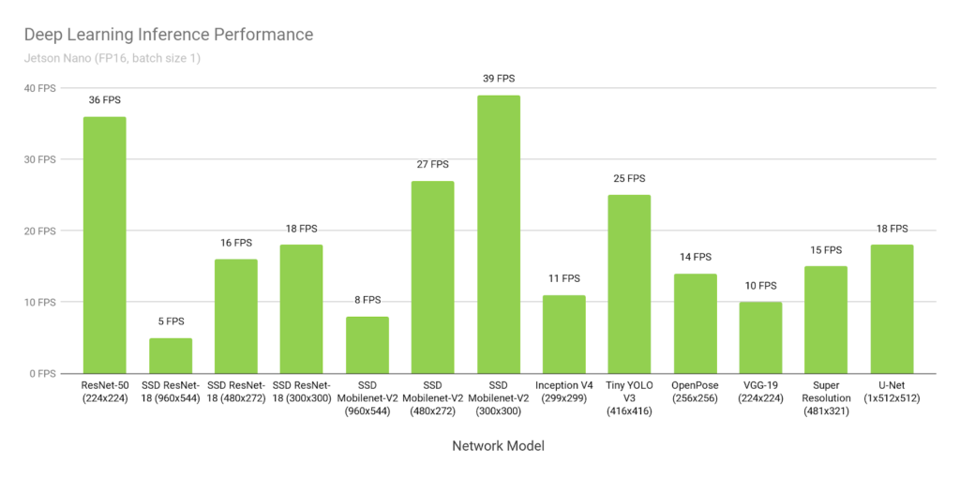
Relevant literature
Jetson Nano: Deep Learning Inference Benchmarks
Jetson Nano can run a wide variety of advanced networks, including the full native versions of popular ML frameworks like TensorFlow, PyTorch, Caffe/Caffe2, Keras, MXNet, and others. These networks can be used to build autonomous machines and complex AI systems with image recognition, object detection and localization, pose estimation, semantic segmentation, video enhancement, and intelligent analytics.

Slide 7
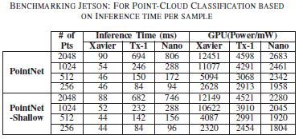
Relevant literature
Benchmarking Jetson Platform for 3D Point-Cloud and Hyper-Spectral Image Classification
This paper benchmarks different Jetson platforms (Nano, TX1, and Xavier) by evaluating their performance based on computationally expensive deep learning algorithms.
Different datasets are used ( 3D Point-Cloud and hyperspectral images(HSI) ) and deep learning algorithms (Point-Net and stacked autoencoders (SAE) )
In the experiments, datasets that are relatively heavier than conventional 2D images are selected.
Among selected Jetson platform for benchmarking, only Xavier can handle training of PointNet with similar results as a desktop while TX1 and Nano are unable to cope with even a single process of training due to fewer memory resources available. However, Jetson platforms are intended to infer only
After evaluating Jetson Xavier, TX1, and Nano based on performance metrics such as inference time, the capability to process multiple instances concurrently, memory consumption per-process, CPU(Power/mw) and GPU (Power/mw):
Xavier outperforms TX1 and Nano with slightly more power consumption.
Xavier is thus a suitable candidate to deploy at edge-server to handle deep learning processing and to provide real-time results to the client under the umbrella of edge-computing.

Slide 8
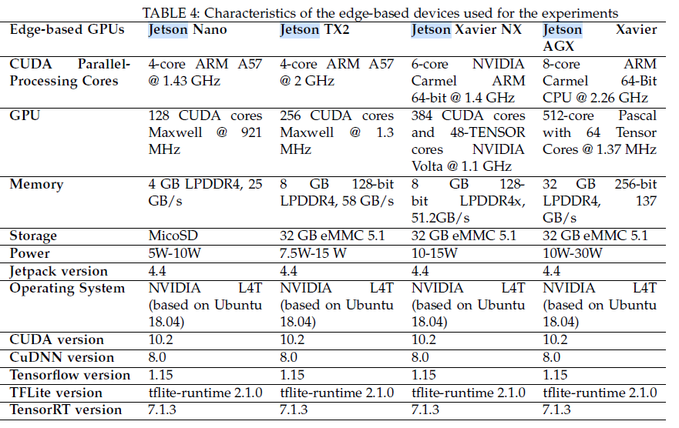
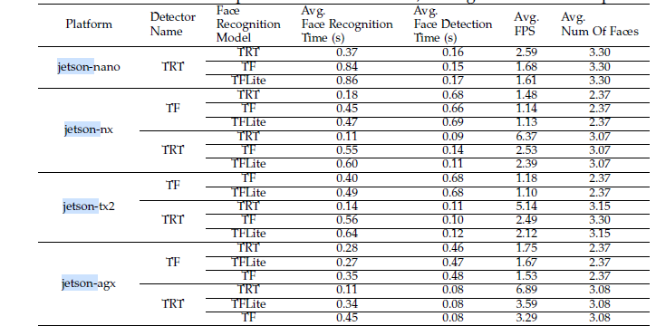
Relevant literature
Cloud versus Edge Deployment Strategies of Real-Time Face Recognition Inference
This paper presents a real-world case study on deploying a face recognition application using MTCNN detector and FaceNet recognizer
Different models of Jetson boards for the edge are considered (Nano, TX2, Xavier NX, Xavier AGX).
The authors also investigate the effect of deep learning model optimization using TensorRT and TFLite compared to a standard Tensorflow GPU model
Face detection and face recognition time: Jetson Xavier AGX is consistently the fastest device, followed by Jetson NX, Jetson TX2. The slowest is Jetson Nano, which cannot run the Tensorflow implementation of MTCNN due to its limited computing capabilities.
MTCNN or Multi-Task Cascaded Convolutional Neural Networks is a neural network which detects faces and facial landmarks on images.
NVIDIA TensorRT speeds up deep learning inference through optimizations and high-performance runtimes for GPU-based platforms
TensorFlow Lite is TensorFlow's lightweight solution for mobile and embedded devices

Slide 9
Relevant literature
Benchmark Analysis of Jetson TX2, Jetson Nano and Raspberry PI using Deep-CNN
In this study, a 2D- CNN model was developed to measure the performance of deep learning applications on a singleboard computer.
The model has been trained and tested in the five different size datasets on single-board computers (NVIDIA Jetson Nano, NVIDIA Jetson TX2, and Raspberry PI 4).
Parameters for performance analysis has been defined as consumption (GPU, CPU, RAM, Power), accuracy and cost.
While Raspberry Pi provides low power and energy saving performance, it is concluded that NVIDIA Jetson platforms such as Jetson Nano, Jetson TX1, Jetson TX2 have higher performance because they have higher speed GPUs.
Jetson Nano shows 2 times lower performance than the Jetson TX2 when running a CNN.
Jetson Nano developer kit has been evaluated to be higher in some deep learning applications than the Raspberry Pi kit.
When comparing the performance of Jetson Nano and Jetson TX2 developers with OpenCV using the OpenCv Template Matching method, it appears that the Jetson TX2 developer kit is on average three times faster than the Jetson Nano developer kit. However, both are very low in terms of processing time.
Jetson TX2 has been shown to have the best power efficiency compared to other Jetson developer kits.

Slide 10
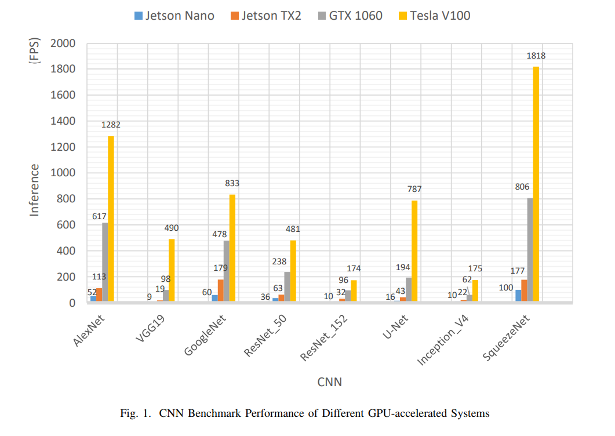
Relevant literature
Benchmarking GPU-Accelerated Edge Devices
This paper compares between the NVidia Jetson Nano, NVidia Tegra X2 (TX2) embedded system, a GTX 1060 desktop system, and a Tesla V100 high-end system across different CNNs
This figure shows the benchmark results in terms of the frames per-second (FPS) inference performance measured across the CNNs, where:
Jetson Nano’s performance is plotted along with other systems for comparison
Jetson Nano shows greater than 30 FPS on 4 CNN benchmarks, which demonstrates that Nano can be adequate for certain real-time applications in deep learning.
Compared with Jetson TX2 which has 2× more accelerator parallelism, Jetson Nano show roughly the same 2× performance decrease in almost all the CNN benchmarks
The results of the evaluation show that Jetson Nano is capable of efficiently running a half of the 8 CNNs used in the benchmark.
Overall, the results demonstrate that Jetson Nano can be adequately used for certain, not-too-complex deep learning applications in real time.

Slide 11
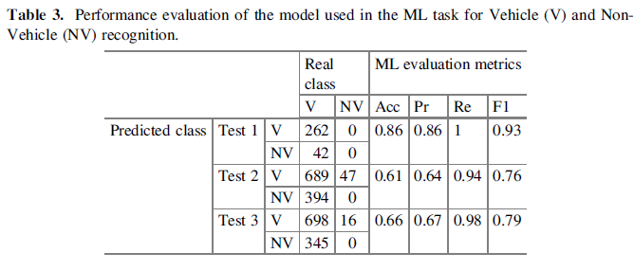
Relevant literature
Performance Evaluation of the Nvidia Jetson Nano Through a Real-Time Machine Learning Application
This article presents an analysis of the performance of the Nvidia Jetson Nano platform and the effectiveness of performing a real-time ML application with YOLO for the recognition and counting of ground vehicles.
Two types of experiments were conducted, the first experiment aimed to evaluate the use of processing resources (CPU and GPU), device temperature, power consumption, and the amount of RAM used in the ML task. The second experiment sought to evaluate the effectiveness of the platform combined with OpenDataCam.
Currently, there are several scientific researches that uses methods for the detection and counting of objects with ML and the nano:
Jetson Nano platform is used for the recognition of traffic signs by means of Convolutional Neural Networks (CNN)
Detect fires through video with deep CNN
The Jetson Nano platform does not have an embedded camera, but in this work, the Nvidia Jetson Nano HD AI model IMX219-77 was used to capture video in real time. The OS used was GNU/Linux Ubuntu 18.04.
The experiments carried out in the first stage were evaluated in three different scenarios in the city of Quito, Ecuador, considering three different time slotsThe results indicate high percentages of sensitivity in all experiments.
The highest precision and accuracy were obtained in the first test (with 86%, respectively), where vehicular traffic was lower and the camera position was higher.

Slide 12
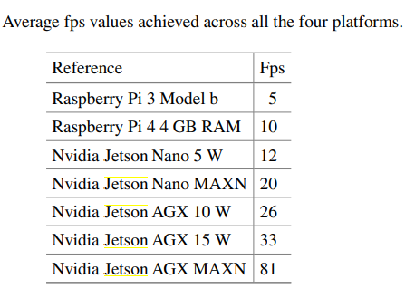
Relevant literature
Analysis and Design of a Yolo like DNN for Smoke/Fire Detection for Low-cost Embedded Systems
This paper proposes a video-based fire and smoke detection technique to be implemented as antifire surveillance system into low cost and low power single board computer (SBC). Such algorithm is inspired by YOLO. Our architecture is based in three main segments: Bounding Box Generator, Support Classifier and Alarm Generator.
The algorithm is tested in four different embedded systems with different price and capabilities: a Raspberry Pi3, Raspberry Pi4 with 4 GB of RAM, an Nvidia Jetson Nano and an Nvidia Jetson AGX Xavier.
The test measures the maximum frame per seconds
The Nvidia Jetson Xavier obtains the best results reaching about 80 frames per second.
The Xavier board is x4 times faster than the Nvidia Jetson Nano and about x16 times faster than the Raspberry Pi 3 that reaches only 5 fps.
The Nvidia Jetson Nano seems to be the ideal compromise between performance and power consumption. In fact, the Raspberry Pi 4 does not get more than 10 fps even if it consumes an average 5 W. The Jetson Nano board gets about 20 fps in 10 W consumption configuration feasible and so can be considered as final platform for a final IoT antifire system

Slide 13
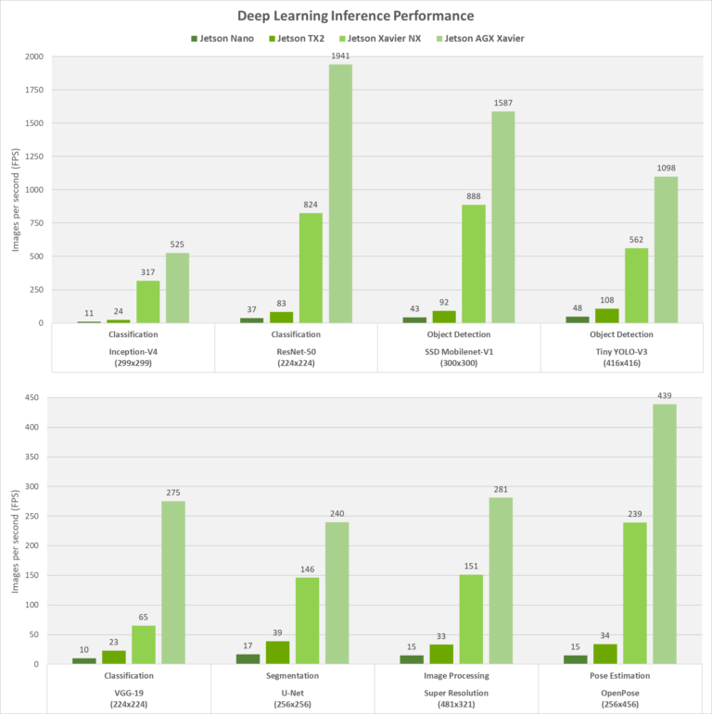
Conclusion
Deep Learning Inferencing Benchmarks
Our end robot should include person detection, breach detection, DRL navigation either with a lidar or a camera
Tensor cores can compute a lot faster than the CUDA cores. CUDA cores perform one operation per clock cycle, whereas tensor cores can perform multiple operations per clock cycle
Jetson Xavier NX uses tensor cores while Jetson TX2 uses Cuda cores
Volta (Jetson Xavier NX ) succeeded Pascal (Jetson TX2) which in turn succeeded the Maxwell GPU architecture (Jetson Nano)
Jetson Nano runs Resnet-50 CNN which is very widely used. However, we cannot be sure that it can hold more than one architecture
4 GB memory may not be on the safe side
Jetson Nano shows 2 times lower performance than the Jetson TX2 when running a CNN
Jetson Xavier NX achieves up to 10X higher performance than Jetson TX2, with the same power and in a 25% smaller footprint.
*FPS (Frame Per Second) defines how fast your object detection model process your video and generate the desired output.
Notes:
https://developer.nvidia.com/blog/jetson-xavier-nx-the-worlds-smallest-ai-supercomputer/#:~:text=Jetson%20Xavier%20NX%20achieves%20up,%2C%20and%2010W%20for%20Nano).

Slide 14
Thesis Updated TOC
A swarm of robots for encouraging desired social behaviors
Introduction
Aim of this work
Challenges
Research Statement and Contributions
Thesis Outline
Background
Swarm robotics
Deep Reinforcement learning
Visual recognition and CNN
Sim2real Gap
Related Work
Describe the papers using a robot for detecting social violations
How is our work different
An Overview of Swarm Robotics
Motivation and Inspiration
Swarm Design
Behavior-based design methods
Automatic design methods.
Testbed Design
Requirements
Architecture
Hardware
Software
Implementation
Social distancing detection
Algorithms used
…
Navigation
Algorithms used
…
Experiments and Results
Cover needed experiments for comparison (if needed)
Results
Comparison with Baselines
Conclusion and Future Work

